Slide 1
Potential tree removal for the lowering of 611 Pleasant street digital sign

Slide 2
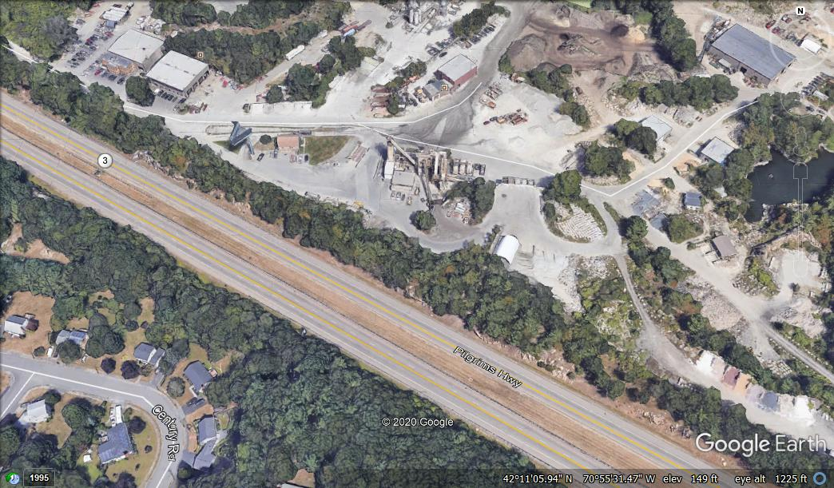
Additional cutting for lowering the height
No previous removals at current height
Wetlands
First cutting same height
Additional cutting for sign lowering

Slide 3
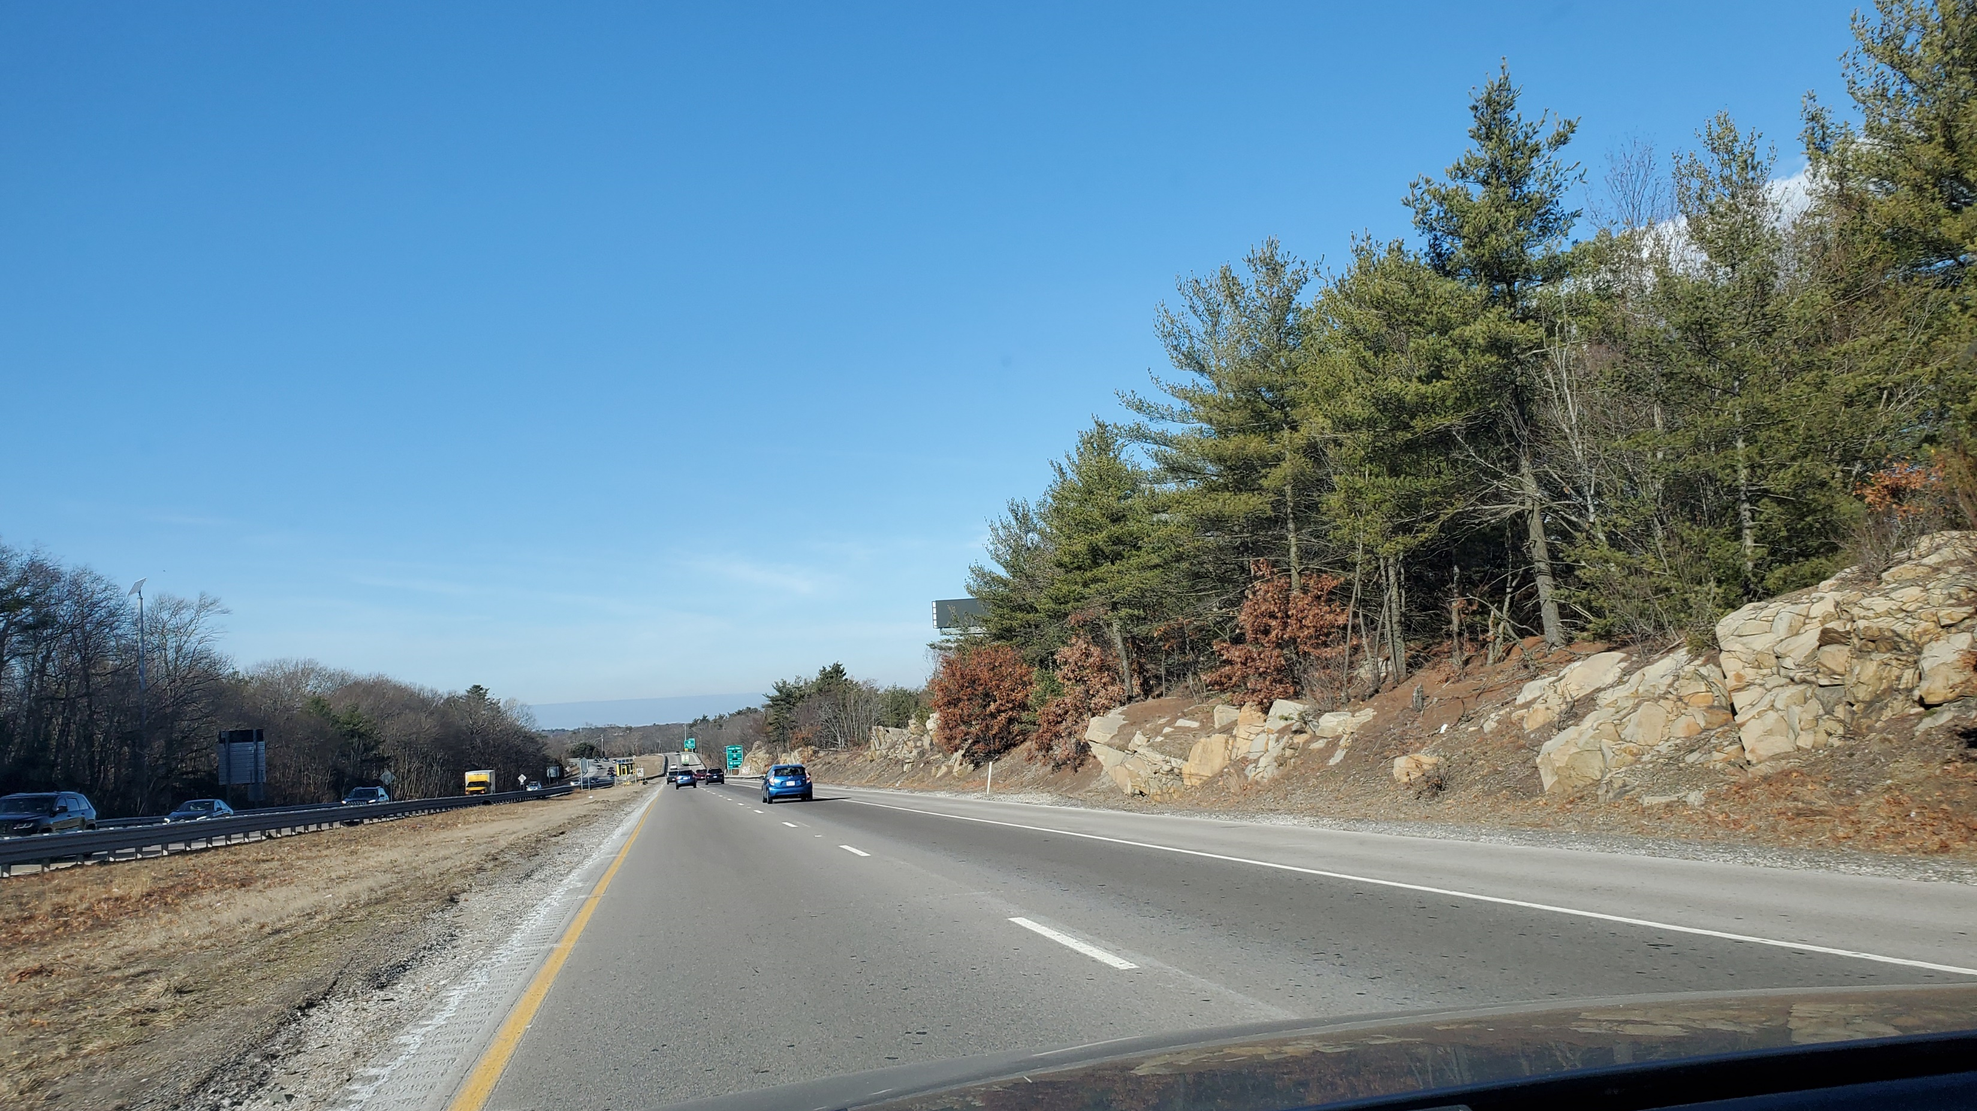
Additional tree removals
Sign lowered 20 feet

Slide 4
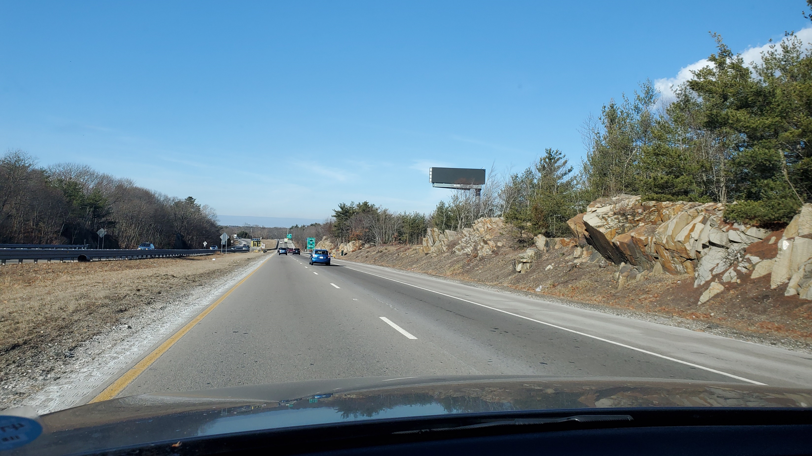
Additional tree removal
Sign lowered 20 feet

Slide 5
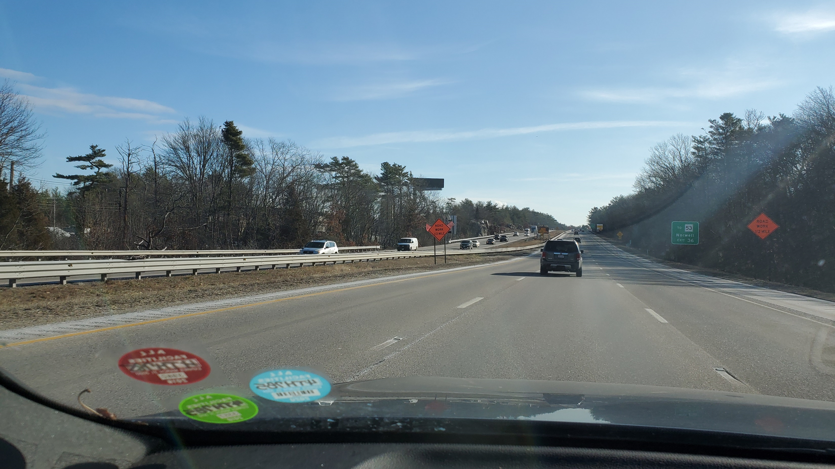
Additional tree removal
Sign lowered 20 feet

Slide 6
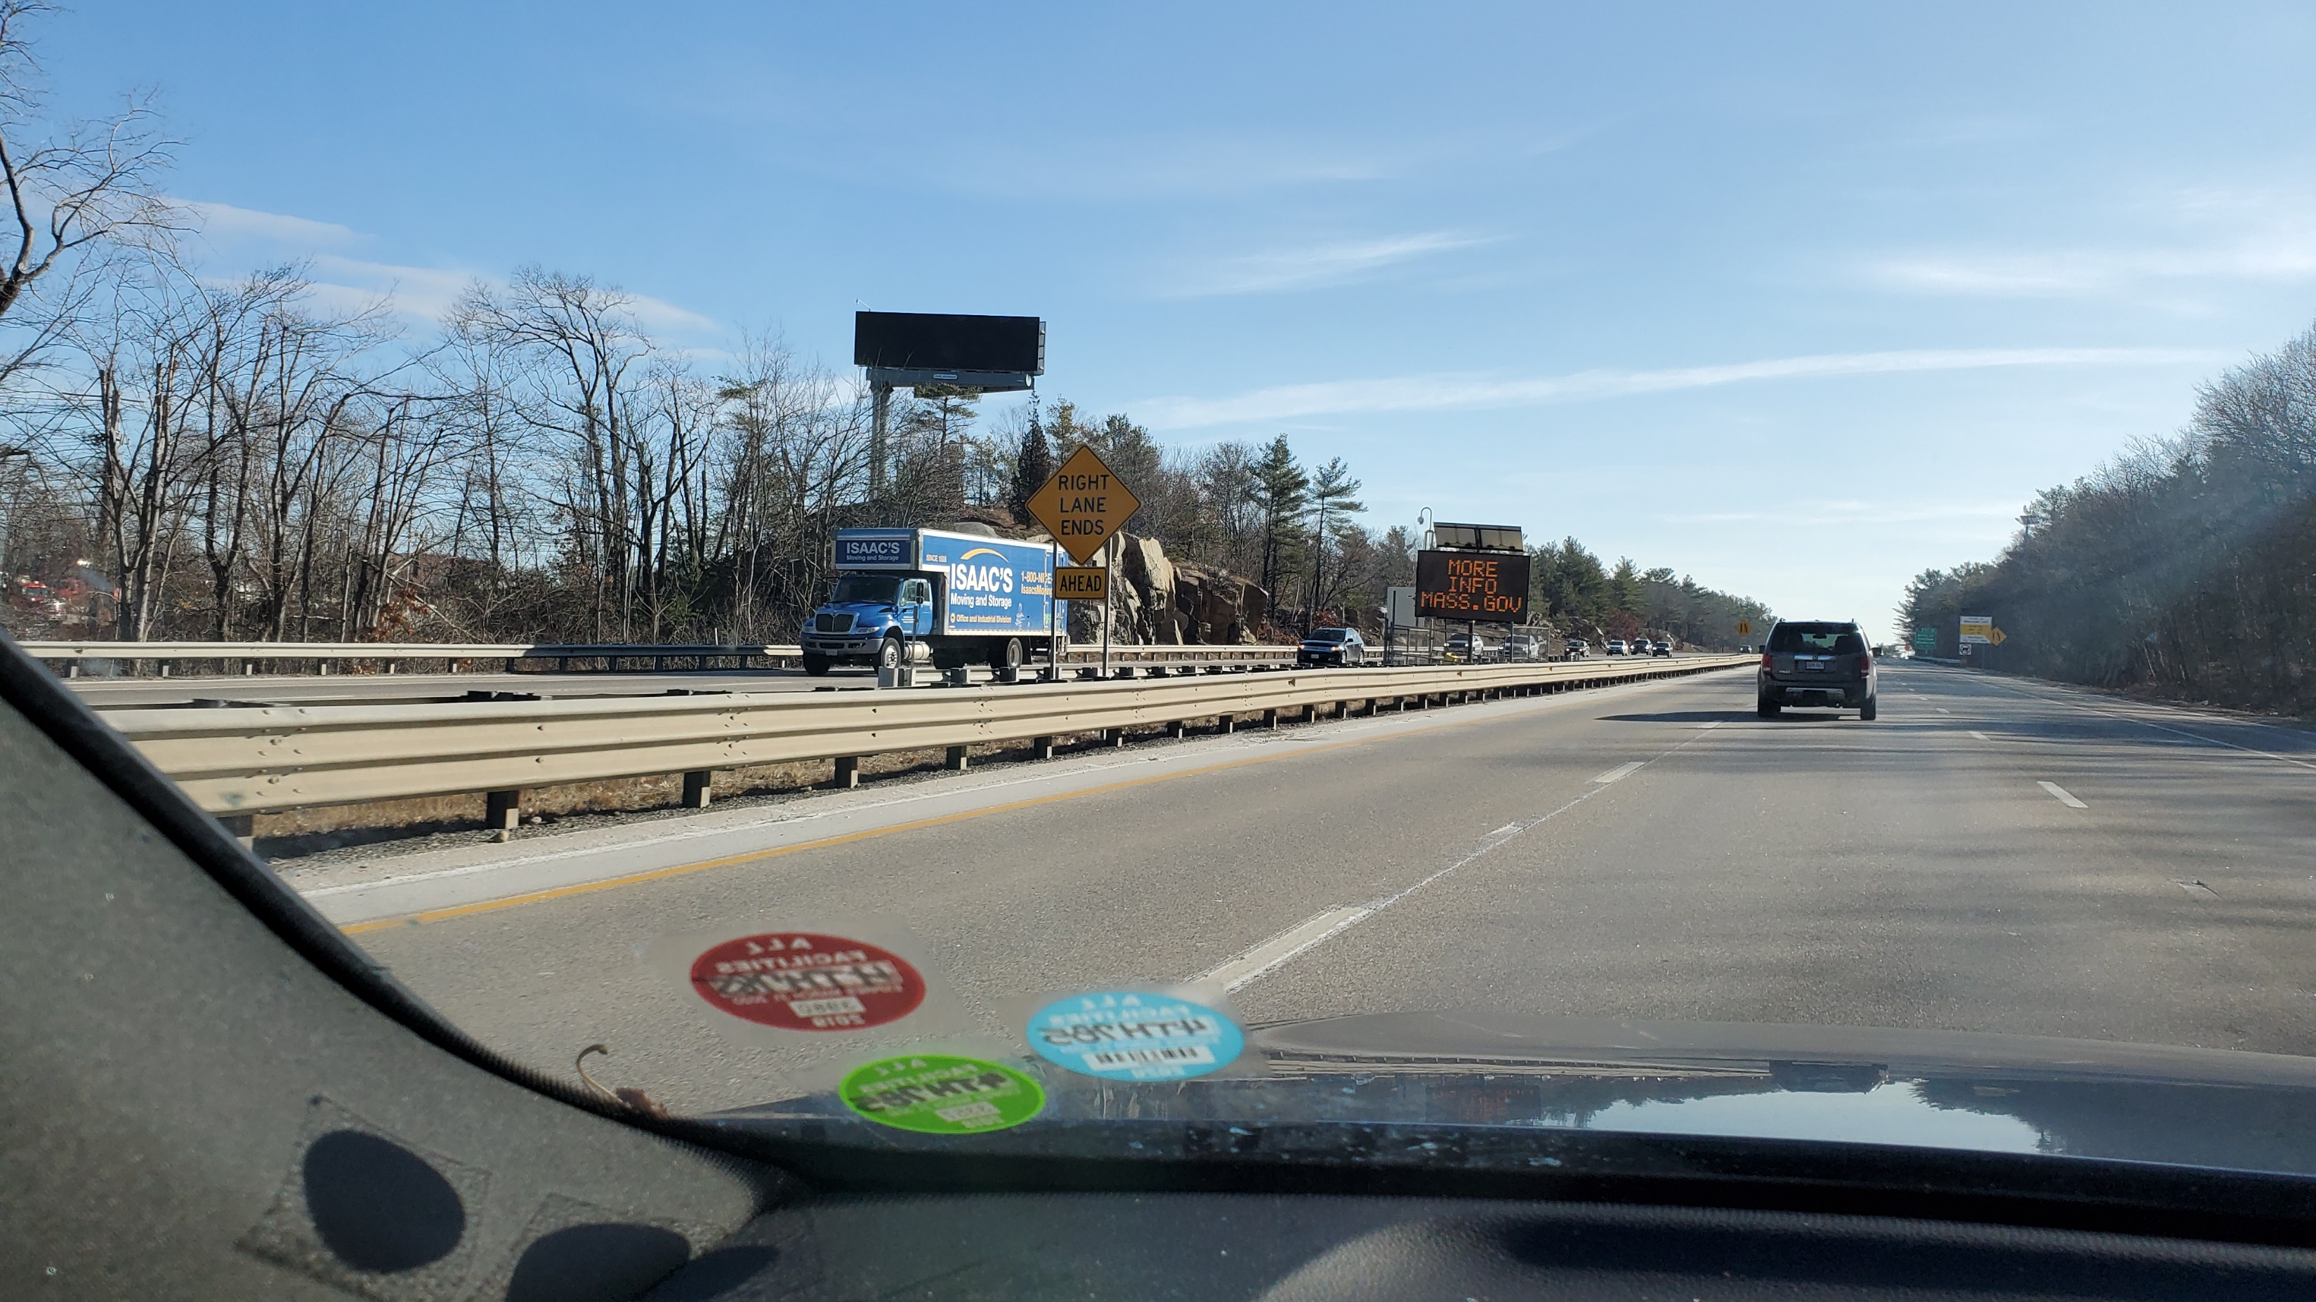
Additional tree removal
Sign lowered 20 feet

Slide 7
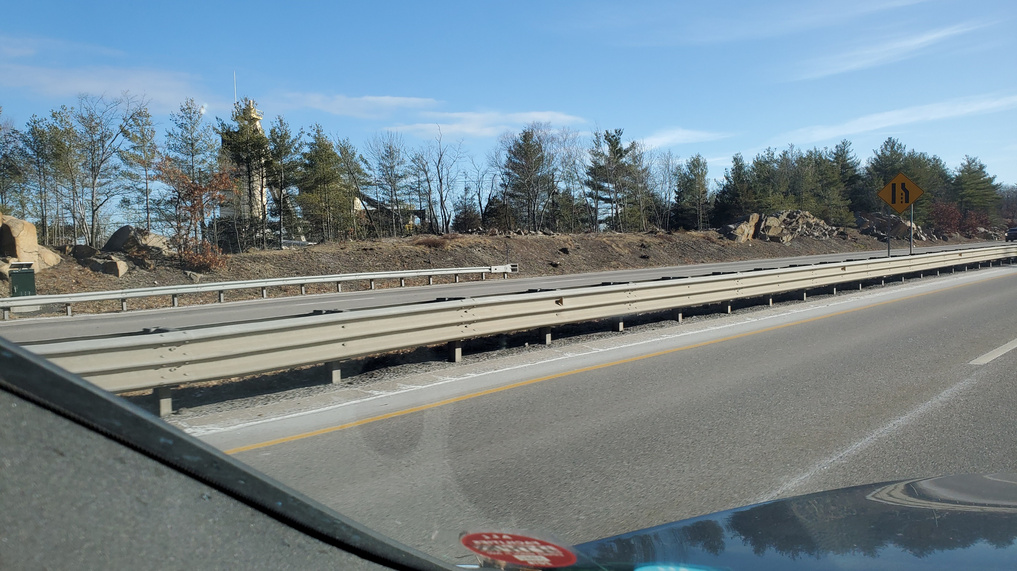
Additional tree removals leaving small canopy when possible

Slide 8
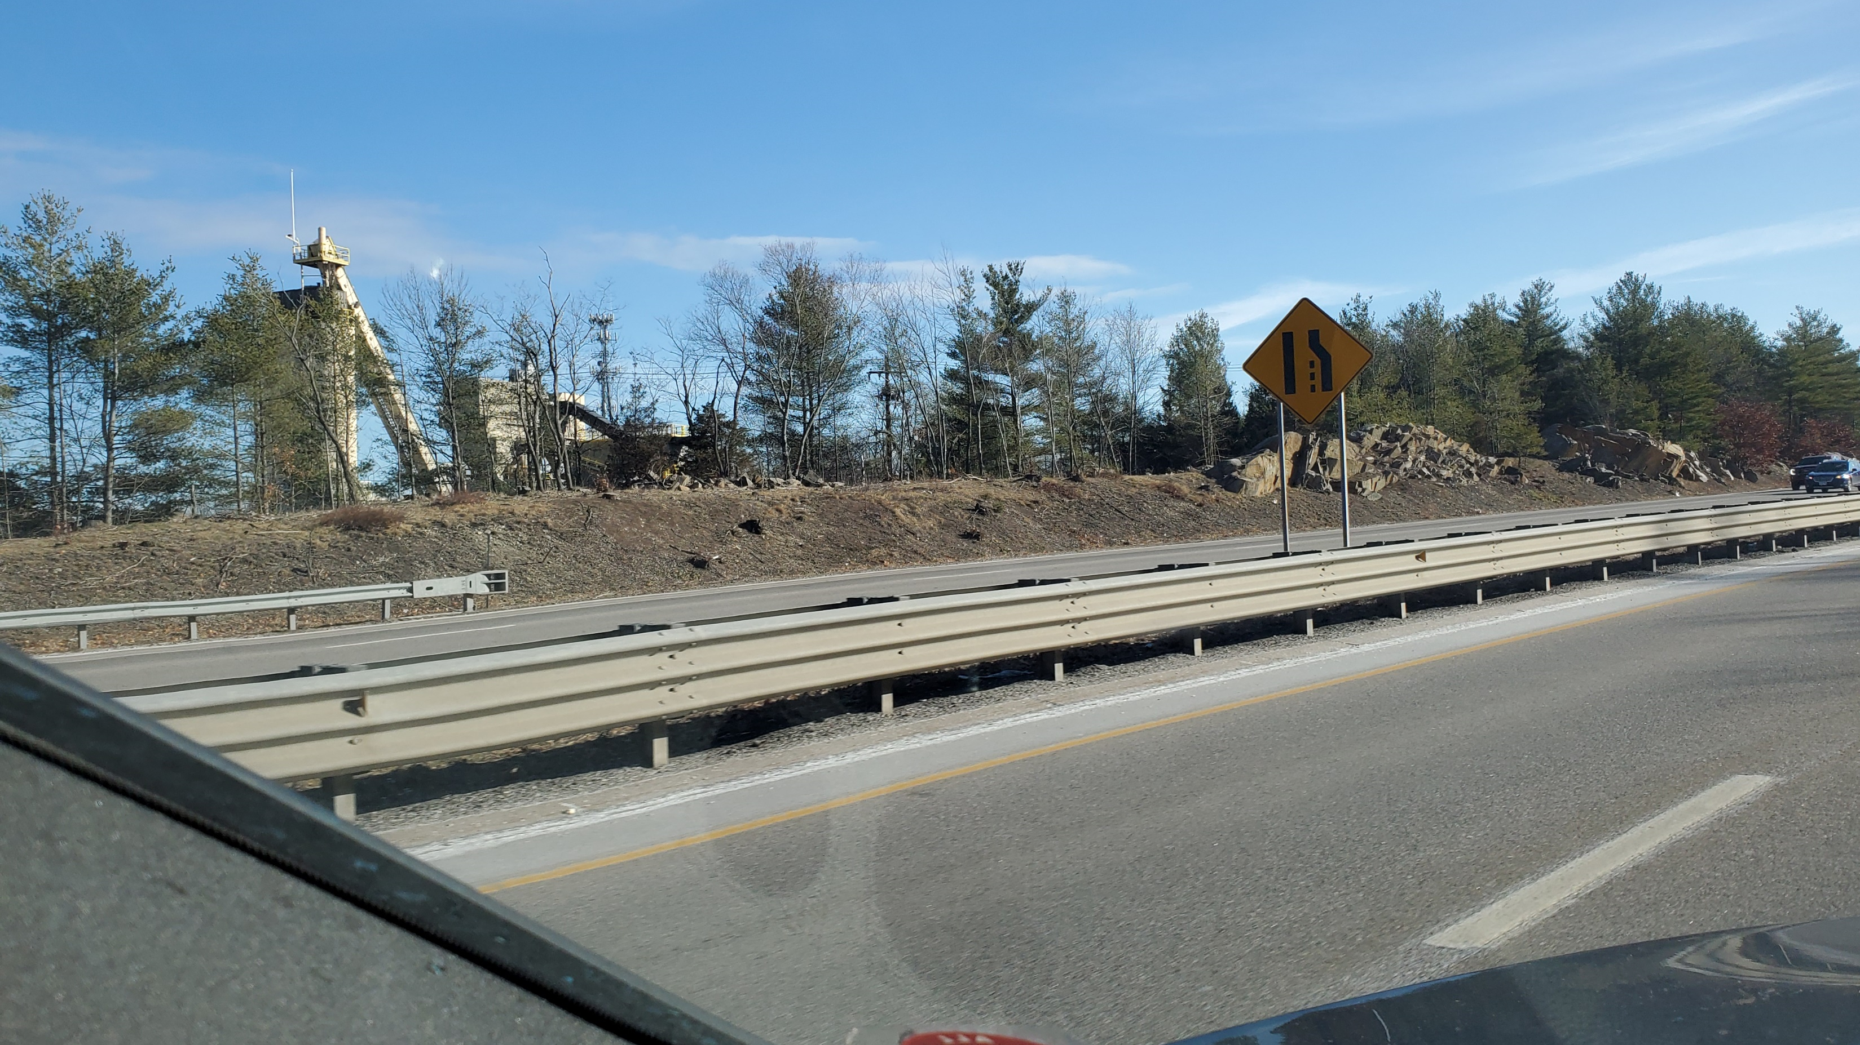
Additional tree removals with some small canopy when possible

