Slide 1
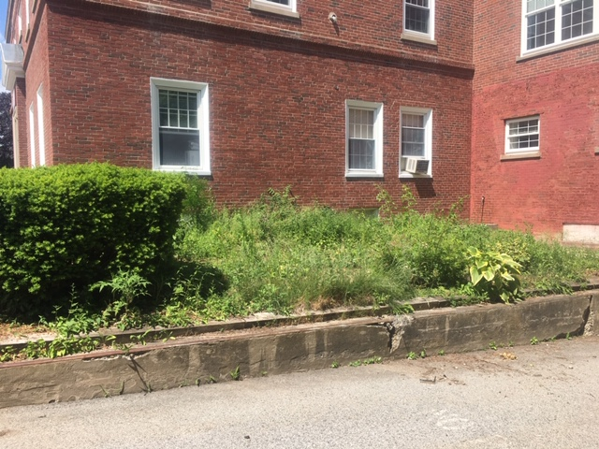
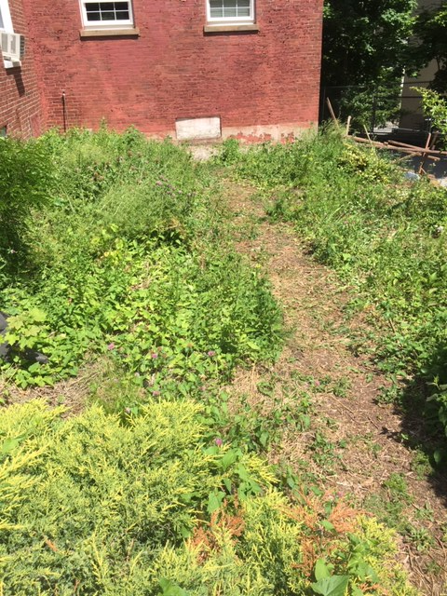
1393 Pleasant street
Weymouth, ma 02189

Slide 2
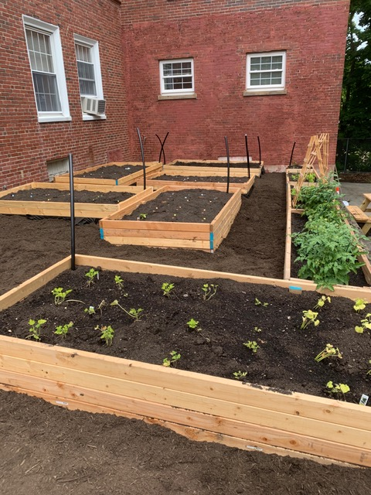
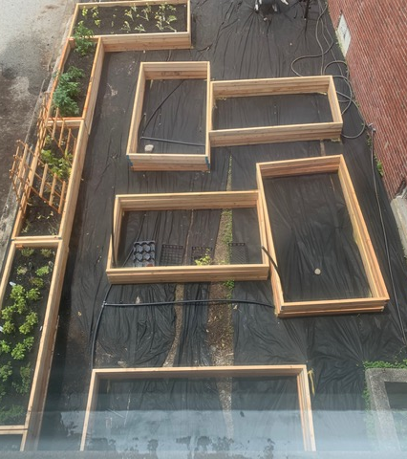
6 Full Beds 4 Single Beds
Irrigation system

Slide 3
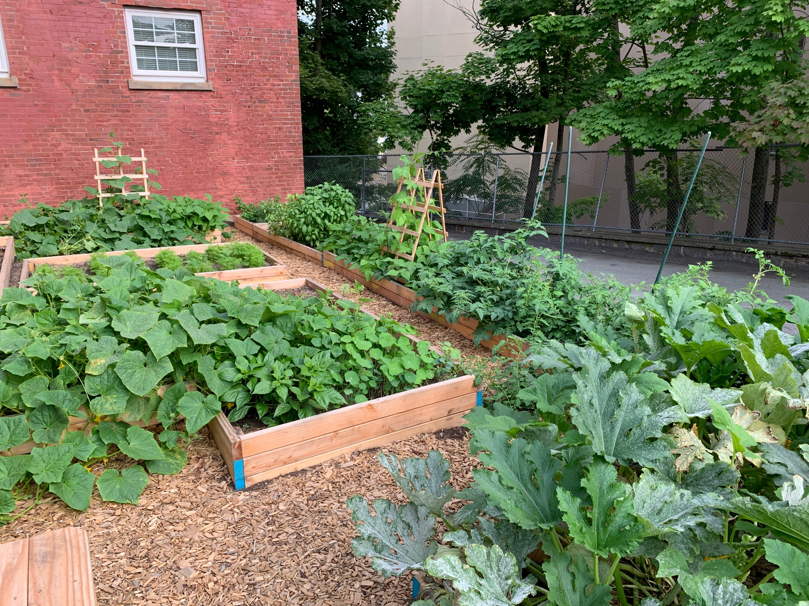
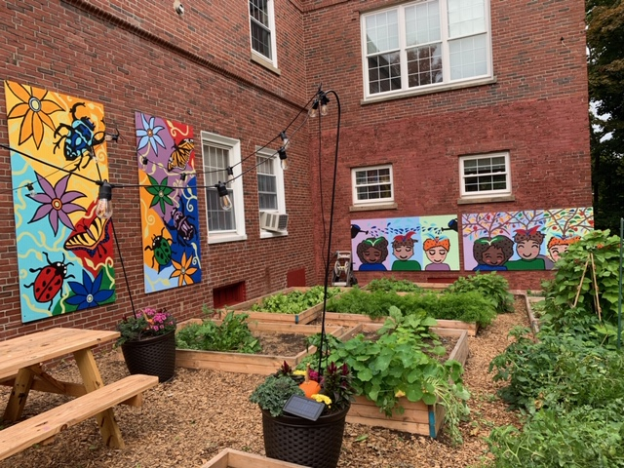
Beans – Carrots - Cucumbers Radishes – Spinach - Squash Tomatoes - Turnips Zucchini
Basil - Cilantro Lavender Mint – Oregano Parsley

Slide 4
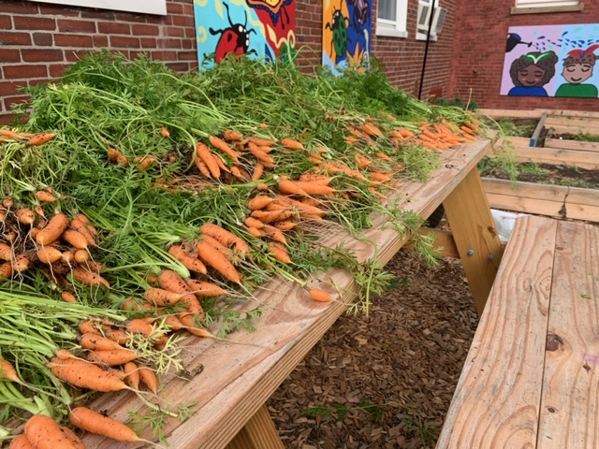
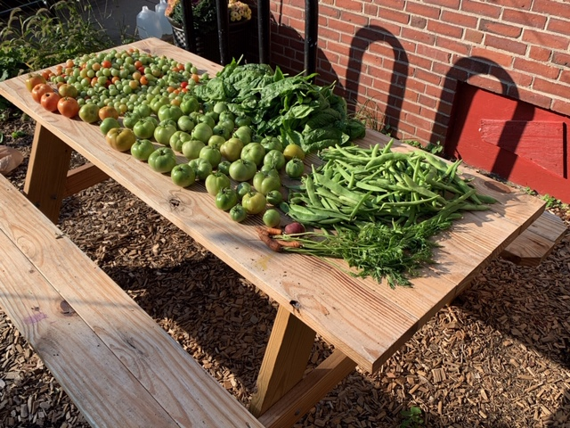
Donated product to 3 Weymouth Food Pantry Sites
The Garden came to life through a municipal - community partnership made possible by the Health Dept, Recreation Dept, Youth and Family Services, the Weymouth Food Pantry and Mass in Motion.

